Slide 1

BeyonDev-Qa Automation
Automation Project Part A
Saeed Esawi
Computer Science Graduate
Gulliver.co.il

Slide 2

Introduction
About my project
Automation tests
Using selenium
Parallel browsers
Goals

Slide 3



What Is Gulliver
Gulliver website

Slide 4





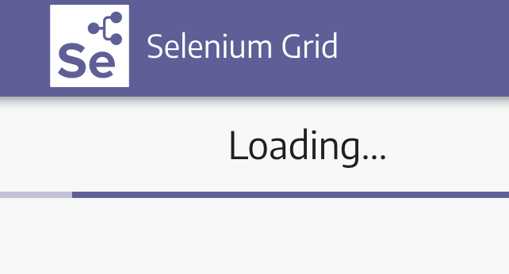
Tools

Slide 5
Test Planning and Documentation
STP
STP (Software Test Plan) Test Planning involves the systematic process of outlining the objectives, scope, resources, and schedules for testing software, ensuring thorough evaluation and validation of its functionality and quality
STD
STD (Software Test Design) Test Planning involves strategizing and outlining the approach, ensuring comprehensive coverage and effectiveness in identifying defects and validating system functionality

Slide 6
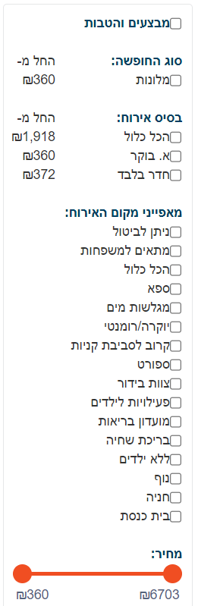
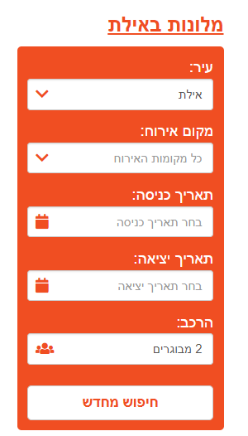
Example of functional tests

Slide 7
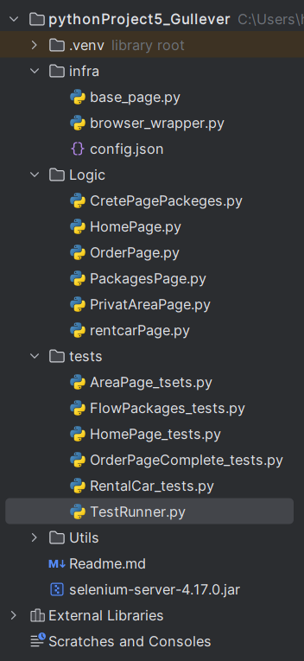
The object model of my project
Infra
Logic
Tests

Slide 8
Test case example
1) The test checks if I can get from the main page to the vacation package page
And he does navigate me correctly and does not take me to another page
stages
1- Go to the site, expect to get the main page of the site
2- Look for vacation packages, expect to get the packages element on the page
3- Click on vacation packages to Crete, expect to receive a page with vacation packages
4- Click on the first vacation package, expect to receive the vacation package page by checking that there is the element of flight and hotel - which is unique for a vacation package
5- Make sure I'm on the package page before proceeding to payment

Slide 9
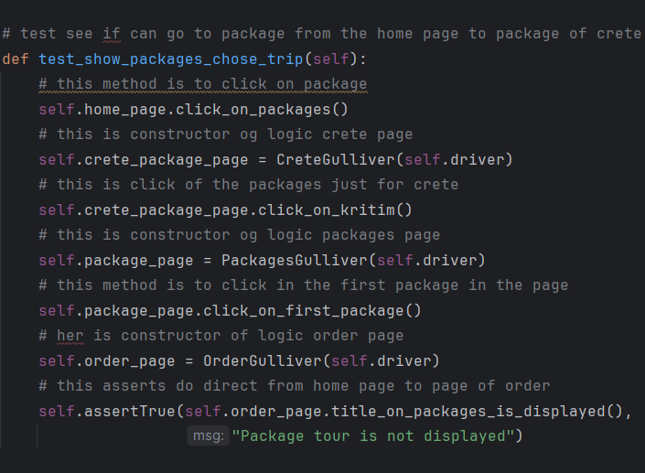
Example test

Slide 10

Bug
שמירת התרגום
שמירת התרגום
Problem
There is a problem with the email. If I enter an incorrect email, it sends yes. You have successfully registered even if the email is incorrect and you receive the email incorrectly.
Solution
The solution is to do a check on the input of the email and check if it passes email checks in the sleepers

Slide 11



Conclusion and Recommendations

Slide 12
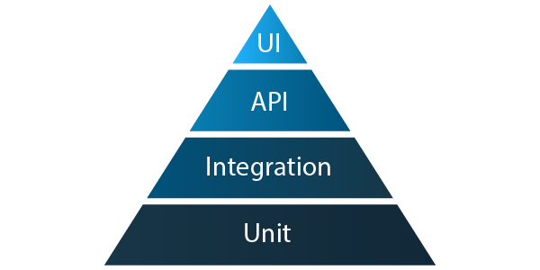
That’s it!
Done √ √

